Slide 1
GUIDED BY: Mrs. T. ABINAYA M.E., SUPERVISOR ASSISTANT PROFESSOR
AN AUTOMATED WASTE SEGREGATION AND MONITORING SYSTEM USING WIRELESS COMMUNICATION
TEAM MEMBERS, DEVA TARSHINI P (912321106024)
SUBITHA B (912321106036)
SWATHI G (912321106037)

Slide 2
ABSTRACT
The Smart Waste Segregation System is an innovative approach to automated waste management using embedded systems and sensor technology. It aims to address the increasing environmental and health issues caused by improper waste disposal by automating the classification of waste materials into biodegradable, non-biodegradable, and metallic categories. The system utilizes an Arduino UNO microcontroller integrated with a conveyor belt mechanism and various sensors—ultrasonic, IR, RGB color, capacitive, and an electromagnet. The waste items are separated to the particular area through funnel, each sensor identifies specific properties of the material, triggering actuators such as an air blower and electromagnet to sort the items into appropriate bins. The system also includes a Bluetooth module for real-time monitoring.

Slide 3
OBJECTIVE
This project “AN AUTOMATED WASTE SEGREGATION AND MONITORING SYSTEM USING WIRELESS COMMUNICATION”, aim to revolutionize waste management by integrating automation, intelligent sensing, and wireless communication to create a more efficient and sustainable solution.
The core of objective is to develop a system that not only monitors waste levels in real-time but also automates the crucial process of waste segregation at the source.
This is achieved by employing a combination of sensors, actuator and micro-controller , all interconnected through a robust wireless communication network.

Slide 4
INTRODUCTION
The world causes a huge problems of waste management. It is very difficult in our nature. Today the number of employers being appointed to attend the cleaning process in our locality but the improper collection of waste will causes uncleanness in our society.
The Global surge in urbanization and industrialization has led to an exponential increase in waste generation, posing significant environmental and public health challenges. Automated waste segregation system promises to revolutionize the waste management industry by ensuring faster, more accurate, and cost effective sorting of waste materials.
The toxic gases are released into the air and in turn the whole ecosystem is affected. The benefits of this work are, the waste has a higher potential for recovery and the occupational hazards of waste separating workers is also reduced.
The benefits of this work are, the waste has a higher potential for recovery and the occupational hazards of waste separating workers is also reduced.
Improve the quality & quantity of recyclable by accurately sorting materials, reducing contamination, and increasing the amount of waste sent for recycling.

Slide 5
LITERATURE SURVEY
AUTHOR | TECHNIQUES | SYSTEMS | DRAWBACKS
Balakrishnan, Swathy, Rosmi Subha (2016) | AI Sorting Techniques | Adaptive and Interactive Modelling System (AIMS) | The error of randomly guessing the class would be 50% and the error of a simple model classifies everything as clear is 40%.
Mittal, Yangzik, Garg, & Krishman (2016) | Detection of Individual Object | Spot Garbage | Garbage detection fails in an insufficiently available image. When there is a similar to garbage, it can misclassify the garbage or sometimes lose the distinct attributes when afar.

Slide 6
LITERATURE SURVEY CONTI…
AUTHOR | TECHNIQUES | SYSTEMS | DRAWBACKS
Xinhua (2017) | Acquisition of images of waste material / acquiring image | Waste Segregation System Using Artificial Neural Networks | No physical mechanical device to categorize wastes into different bins. Accuracy rate should be added to train the data set.
Myra G. Flores & J. Tan (2019) | Machine Learning | Intelligent Waste Separator (IWS) | The capacities of waste separator do not allow in obtaining information and response is slow.

Slide 7
LITERATURE SURVEY CONTI…
AUTHOR | TECHNIQUES | SYSTEMS | DRAWBACKS
Gaurav & Sharma (2021) | Inductive & infrared sensors | Metal & plastic waste detection | Struggles with wet waste classification
Fernando et al. (2023) | IoT + Blockchain | Blockchain-based waste tracking | High setup cost

Slide 8
BLOCK DIAGRAM OF EXISTING METHOD

Slide 9
CONCEPT OF EXISTING METHOD
IR sensor senses whether the waste bin is filled or not. If the bin is filled, then the IR sensor senses it and gives information to the PIC16F877A microcontroller.
Then according to the coded program in the microcontroller, after a delay of 5 seconds servo motor rotates the waste bin in 120°and hence allows the wastes to fall onto the sub conveyor. Sub conveyor starts to roll.
Now the wastes are falling onto the main conveyor. Based on the time delay given in the microcontroller program, after some delay main conveyor starts to roll while sub conveyor stops it working.
Waste is falling upon the segregation bin, where metallic, dry and wet sensors are placed. Metallic inductive proximity sensor, moisture sensor is fixed and connected in the segregation bin.

Slide 10
CONCEPT OF EXISTING METHOD CONTI…
IR sensor is also fixed at the end section of main conveyor for the purpose of waste arrival detection, it causes the segregation bin to rotate in 120° according to the program.
Three different collecting bins are connected upon the servo motor. The servo motor rotates in clockwise or counter clockwise directions based on the type of waste and waste falls on to the particular waste collecting bin. Namely metal, wet, dry waste bins are placed.
If a metal waste is detected it falls upon metal bin. If a wet waste is detected it falls upon wet bin and if the dry waste is detected it falls upon dry bin.

Slide 11
EXISTING METHOD’S LIMITATIONS
Contamination issues due to mixed waste.
Limited ability to handle complex waste types.
Time consume.
Need Constant power supply.
No storage space.
Need man power to collect the trash.
May be specialized issue happens.
Single objects to be recognized and classified.

Slide 12
PROPOSED METHOD
Automatic waste segregation systems represent a significant advancement in sustainable waste management by integrating sensor technologies and automated control to efficiently sort waste into appropriate categories. At the core of these systems is the Arduino Uno microcontroller, which acts as the central processing unit, coordinating the actions of various sensors and actuators to achieve accurate segregation. The process begins where an infrared (IR) sensor detects the presence of an object and signals the Arduino Uno to initiate the classification sequence. The system then utilizes a combination of sensors, such as capacitive proximity sensors to identify non-metallic materials like plastics. The capacitive sensor works by detecting changes in capacitance caused by dielectric materials, which is crucial for separating organic from inorganic materials.

Slide 13
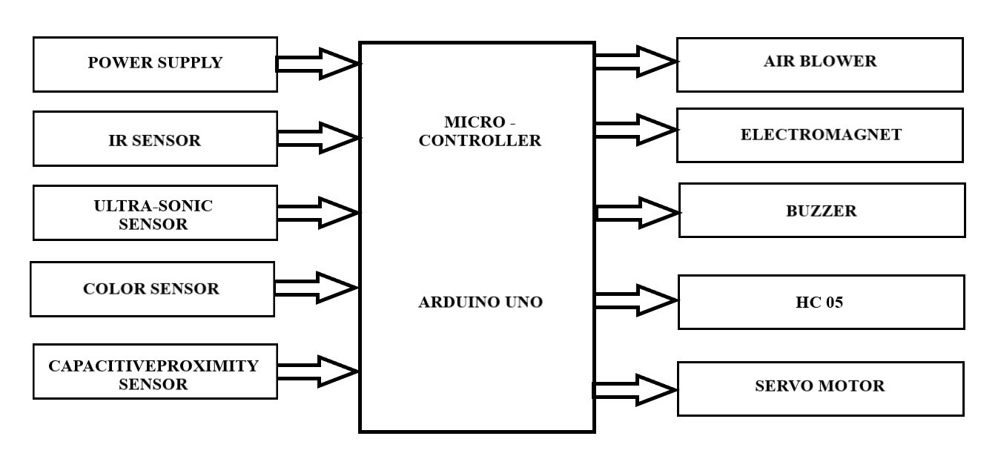
PROPOSED METHOD’S – BLOCK DIAGRAM

Slide 14
BLOCK DIAGRAM DESCRIPTION
In this proposed method, we have used sensors to detect the waste entering the bin and split them on the basis of sensor data. As said earlier using of AIMS and image processing consumes many more time to sense and categories the waste. Most of the segregation systems use sensors for the single object or waste deduction, in our proposed method we developed the system which can segregate the waste as we disposed (group of waste).

Slide 15
INPUT SECTION OF AN BLOCK DIAGRAM
Input Section
The input section consists of various sensors responsible for detecting and analysing waste characteristics. The first sensor in operation is the Infrared (IR) sensor, which detects the presence of waste at the entry point. Once waste is detected, the system begins classification. The Ultrasonic sensor continuously monitors the fill level of the waste bins to prevent overflow. A Color sensor (TCS3200) is used to identify the type of material based on color attributes, particularly distinguishing organic materials. The Capacitive proximity sensor is used to identify non-metallic substances like plastics and food waste by detecting variations in dielectric constants. These inputs are processed by the Arduino Uno to determine the nature of the waste and execute the appropriate response.

Slide 16
OUTPUT SECTION OF AN BLOCK DIAGRAM
Output Section
The output section includes all the actuators and communication modules that respond based on the input data. Upon IR sensor activation, the Air blower is triggered to divert lightweight waste such as paper and plastic. Simultaneously, the Electromagnet is activated to attract and extract ferrous materials. After classification by the color and capacitive sensors, the Arduino activates a Hydraulic push cylinder to sort waste into designated bins accordingly. If the ultrasonic sensor detects that a bin is nearing full capacity, a Buzzer is sounded to notify maintenance personnel. Additionally, the system employs an HC-05 Bluetooth module to wirelessly communicate real-time status updates and alerts to a mobile application or remote monitoring station. All output components function under the control of the Arduino Uno, ensuring seamless operation and accurate segregation.

Slide 17
TOOLS USED
Microcontroller - “Arduino Uno”
IR Sensor
Electromagnet
Air Blower
Ultra-Sonic Sensor
Bluetooth Module(HC-05)
1 Channel Relay
Jumping wires
12V Power Supply
Colour Sensor Module (TCS 3200)
Capacitive proximity Sensor
Servo Motor

Slide 18
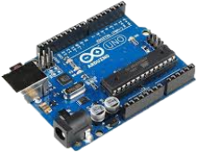
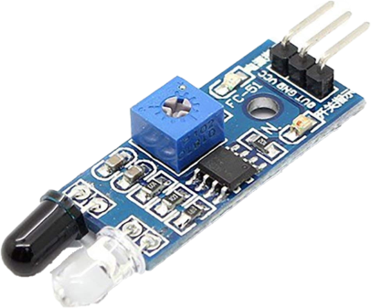
TOOLS USED CONTI…
1. Arduino Uno
Role: The central controller for your system. It will take input from the sensors, process it, and control outputs like the electromagnet, air blower, and relay.
Function: The Arduino will control the entire waste segregation process by determining the type of waste based on sensor data and activating the corresponding actions (e.g., triggering the electromagnet or air blower).
2. IR Sensor
Role: Used to detect the presence of waste.
Function: The IR sensor can detect the position or proximity of waste in a specific location (like a waste bin). The Arduino can then take action based on whether waste has been detected.

Slide 19
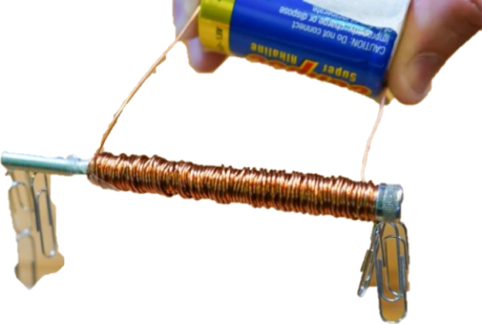
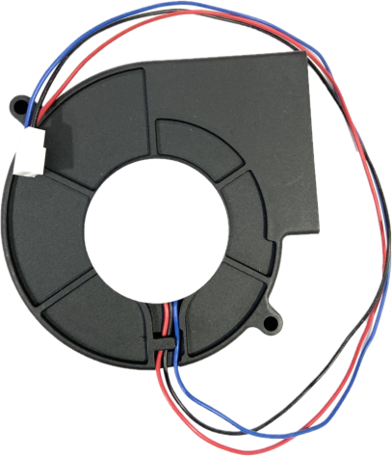
TOOLS USED CONTI…
3. Electromagnet:
Function: An electromagnet can be used for separating ferrous materials (such as metal waste). When activated, it creates a magnetic field that attracts metal objects and sorts them out from other materials like plastic or paper. The electromagnet can be controlled by the Arduino through a relay.
4. Air Blower:
Function: The air blower can be used to blow away lightweight materials such as paper or plastic. The system could be programmed to activate the blower when a particular type of waste is detected, and the force of air will blow the material into the correct compartment for further sorting.

Slide 20
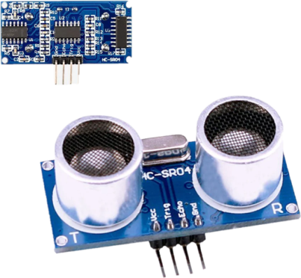
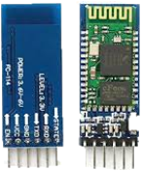
TOOLS USED CONTI…
5. Ultra-Sonic Sensor:
Function: The ultrasonic sensor measures the distance between the sensor and the waste object. This can be used to determine the size or volume of the waste item. For example, larger items could be separated from smaller ones, or it could be used to measure the level of waste in the segregation bins to determine when the bins are full.
6. Bluetooth Module (HC-05):
Function: The Bluetooth module allows for wireless communication between the Arduino and a mobile phone or other Bluetooth-enabled devices. It can be used for monitoring and controlling the waste segregation system remotely. For example, users could adjust settings, check system status, or receive alerts about waste bin levels using a smartphone app.

Slide 21
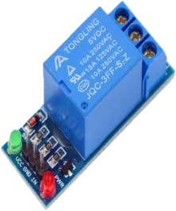
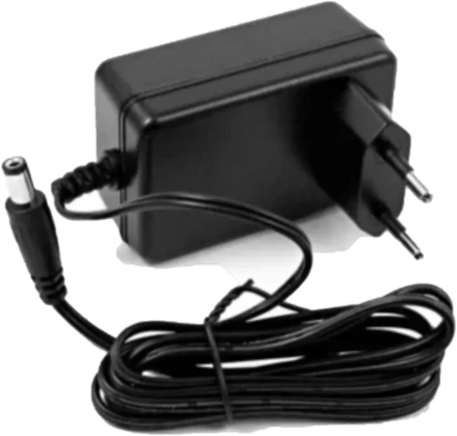
TOOLS USED CONTI…
7. 1 Channel Relay:
Function: A relay acts as a switch to control higher voltage components such as the air blower, electromagnet. The Arduino can control the relay, which in turn controls the operation of these devices based on the system’s requirements. For example, the relay could be used to turn on the electromagnet or air blower when the appropriate waste is detected.
8. 12V Power Supply:
Function: The 12V power supply provides the necessary voltage to power the system, including the Arduino Uno, sensors, and high-power devices such as the air blower and electromagnet. It ensures that the entire system has sufficient power to operate effectively.

Slide 22
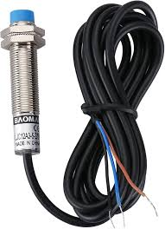
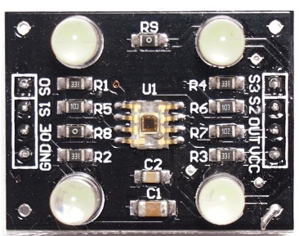
TOOLS USED CONTI…
9. Capacitive Proximity Sensor:
Capacitive proximity sensors (CPS) are sensing device designed to detect both metallic and non-metallic targets. They can detect lightweight or small objects that cannot be detected by mechanical limit switches. CPS are ideally suited for plastics and other non-metallic targets, for liquid level control and for sensing powdered or granulated material.
10. Color Sensor Module TCS3200:
A color sensor is a simple and easy-to-use device that can be used to identify the color of an object and after detecting the color, appropriate action can be triggered. This type of sensor provides easy solutions for sorting and packaging in an industrial environment while expensive sensors are used in industries, the economical ones such as TCS3200 can be used for less demanding DIY Applications.

Slide 23
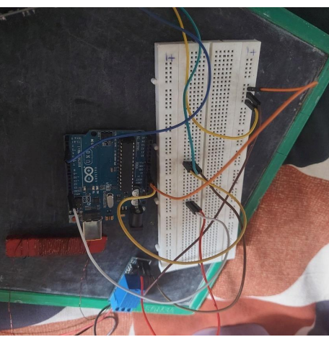
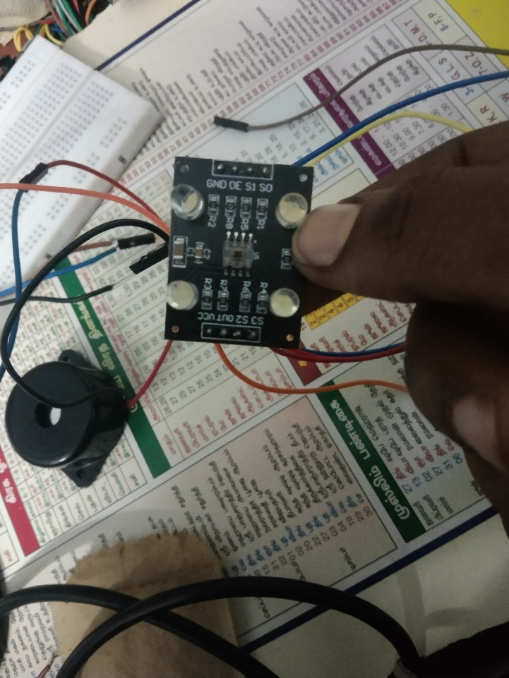
HARDWARE TESTING OF THE PROPOSED METHOD

Slide 24
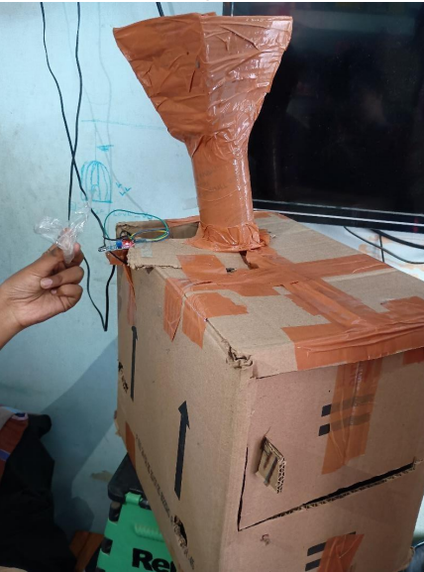

HARDWARE TESTING OF THE PROPOSED METHOD CONTI…

Slide 25
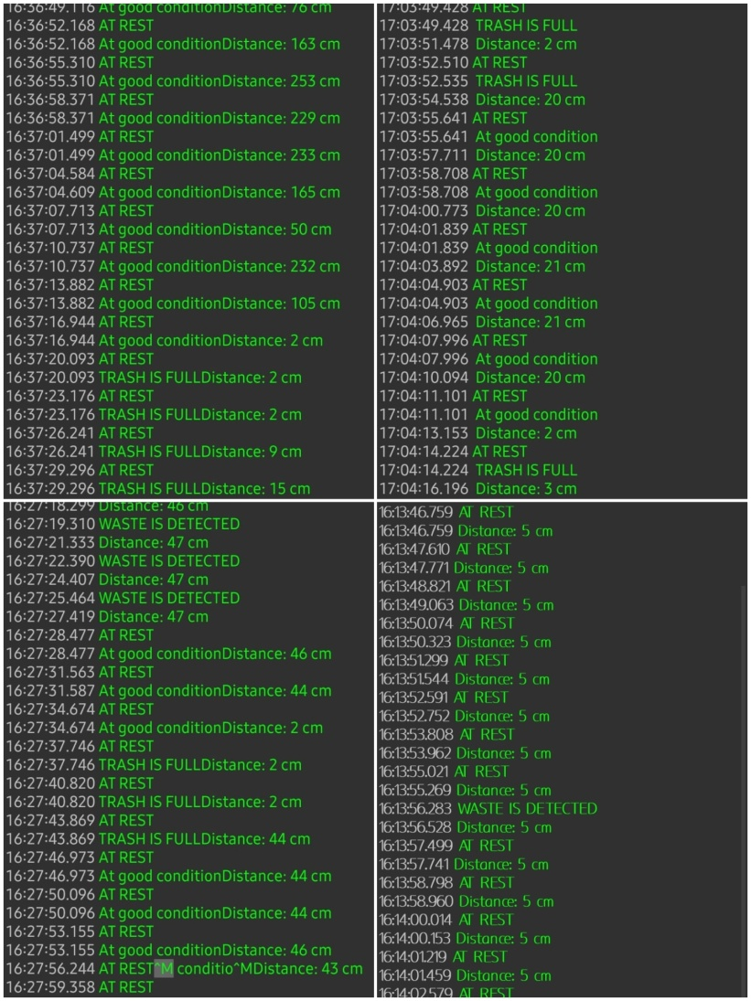
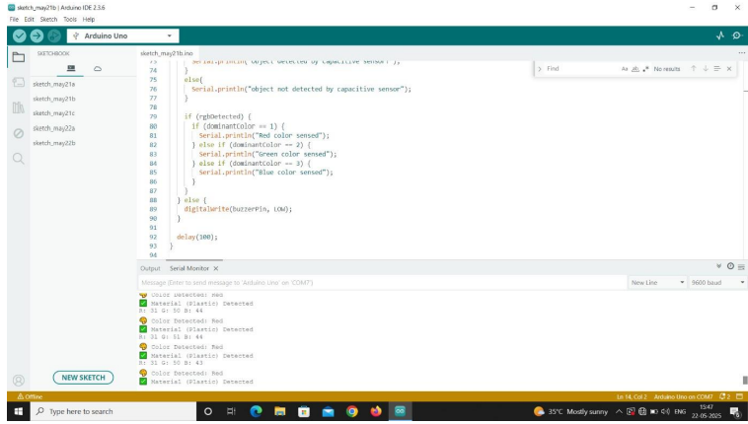
SOFTWARE TESTING OF THE PROPOSED METHOD

Slide 26
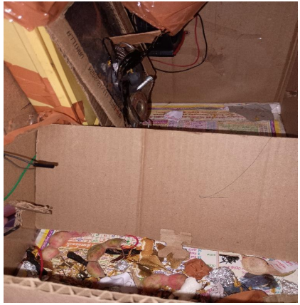
OUTPUT OF THE PROPOSED METHOD
The system detects lightweight waste using an IR sensor. Once detected, a relay activates an air blower to push the item into the appropriate bin. This mechanism ensures efficient separation of light materials like paper and plastic. The process is fast, reliable, and minimizes manual intervention in waste handling.

Slide 27
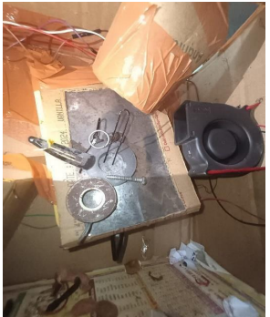
OUTPUT OF AN ELECTROMAGNET WASTE SEGREGATION
Metallic waste is detected using a sensor and directed beneath an electromagnet. The relay activates the electromagnet, attracting ferrous items like iron or steel. These items are lifted or deflected into a separate collection bin. This allows effective separation of magnetic metals from the general waste stream.

Slide 28
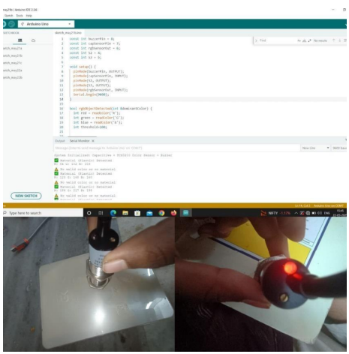
OUTPUT OF AN CAPACITIVE PROXIMITY SENSOR WASTE SEGREGATION
The capacitive sensor detects material type based on dielectric properties. It distinguishes between organic and inorganic items by sensing proximity. When triggered, it signals the system to divert the object accordingly. This method enhances precision in segregating food waste from dry materials.

Slide 29
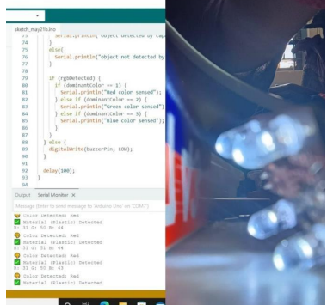
OUTPUT OF AN COLOR SENSOR WASTE SEGREGATION
The RGB color sensor identifies waste items based on their surface color. Detected colors are compared to predefined thresholds set in the Arduino code. Based on color, the system activates sorting mechanisms to route the item. This helps separate recyclables like green glass, colored plastics, or paper.

Slide 30
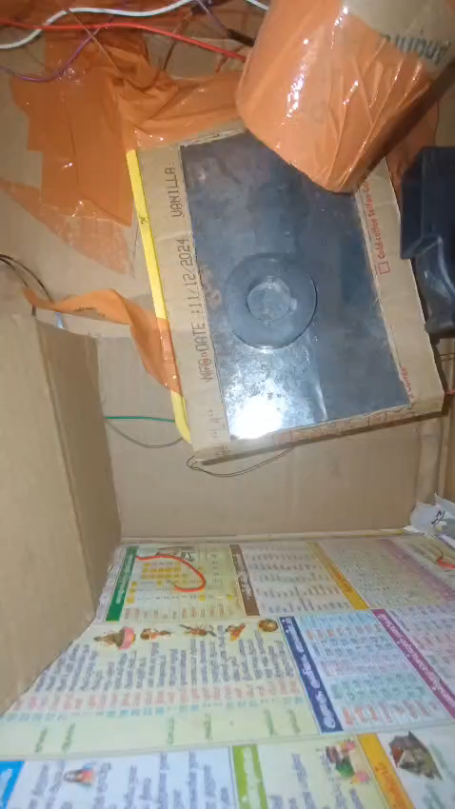
FINAL OUTPUT

Slide 31
APPLICATION
Residential areas.
Commercial places.
Public spaces.
Industrial facilities.
On-site handling & storage.
Waste to energy plants.
Municipal waste management.

Slide 32
ADVANTAGES
Increased efficiency and reduced labour cost.
Improve public health & society.
Reduced green house gas emissions.
Scalability & flexibility.
Increase recycling rates.
Real-time monitoring.
Make unloading trash all the more spotless.
Reduce the land occupation.

Slide 33
DISADVANTAGES
Cannot handle complex or mixed-material items (e.g., metal-coated plastics).
Sensor accuracy can be affected by dust, moisture, or lighting.
Suitable only for small-scale or lightweight waste; may not support heavy industrial items.
Sensors and actuators may require periodic calibration and cleaning.

Slide 34
CONCLUSION
An automatic waste segregation system leveraging wireless communication offers a powerful solution for improving waste management efficiency and promoting sustainable practices by enabling real-time data transmission from bins to a central monitoring station, thus optimizing collection routes and reducing operational costs and environmental impact. This approach leads to enhanced efficiency through reduced manual labour and optimized logistics, greater segregation accuracy for purer waste streams, data-driven decision-making for better resource allocation, and significant environmental benefits like increased recycling rates and lower emissions. Furthermore, integrating these systems with the circular economy, fostering user engagement through feedback and incentives, and establishing industry standards for scalability are crucial steps to transform them into essential components of smart, sustainable cities, contributing significantly to global waste reduction and resource conservation.

Slide 35
REFERENCE
Amrutha Chandra Mohan, Joyal Mendonca, Nikhil Ravi Shankar & Nikhil U. Baheti,“Automated Waste Segregator”, Texas Instruments India Educator’s Conference, 2014,IEEE publication.pp. 1-6.
Hitesh Poddar, Rituraj Paul, Sourangsu Mukherjee, Budhaditya Bhattacharyya, “Design of Smart Bin For Smarter Cities”, International Conference on Innovations in Power and Advanced Computing Technologies, 2017.
“Automatic Waste Segregation” Nimisha S Gupta, Deepthi V, Mayakunnath, Rejeth Pal S, Badsha T S, Nikhil Binoy C
VJ, A., Balakrishnan, K., Rosmi, T.B., Krishna, K.S., Sreejith, S. and Subha, T.D., 2016. Automatic waste segregator and monitoring system. Journal of Microcontroller Engineering and Applications, 3(2), pp.1-7.
Leo, L.M., Yogalakshmi, S., Simla, A.J., Prabu, R.T., Kumar, P.S. and Sajiv, G., 2022, February. An IoT based automatic waste segregation and monitoring system. In 2022 Second International Conference on Artificial Intelligence and Smart Energy (ICAIS) (pp. 1262-1267). IEEE.
”Muhammed Rafeeq, Ateequ Rahman,Mikdad, SanjarAlam. ”Automation of Plastic, Metal and Glass Waste materials Segregation Using Aurdino in Scrap Industry”IEEE publication, pp.1-5.

Slide 36
REFERENCE CONTI….
Theodros Anagnostopoulos,Member of IEEE,Arkady Zaslavsky,Senior member IEEE, “Challenges and Opportunities of Waste Management in IOT enabled Smart Cities:A Survey”,IEEE Transactions on Sustainable Computing.
Dr.N.Sathish Kumar,B.Vijayalakshmi,R.Jenifer Prarthana,A.Shankar, “IOT Based Garbage alert system using Arduino UNO”,2016 IEEE Region 10 Conference(TENCON)
S.M Dudhal,B.S Jonwal,Prof. H.P Chaudhari, “Waste Segregation Using Programmable Logic Controller”, International Journal for Technological Research in Engineering ,Volume 1,2016
Jose M Gutierrez,Michael Jensen, Morten Henius,Tahir Riaz, “Smart Waste Collection System Based on Location Intelligence", Conference Organized by Missouri University of Science and Technology 2015.
Adil Bashir,Shoaib Amin Banday,Ab.Rouf Khan, Mohammed Shafi, “Concept, Design and Implementation of Automatic Waste Management System", International Journal on Recent and Innovation Trends in Computing and Communication ISSN 2321-8169,Volume:1 Issue:7
Adhrisya,Aiswarya,Ambili,Veena Mohan,Jancy, “Centralized Waste Segregation System”,IJSRD Volume 4,Issue 01,2016

Slide 37
REFERENCE CONTI….
Gundupalli, S.; Hait, S.; Thakur, A. A review on automated sorting of source-separated municipal solid waste for recycling. Waste Manag. 2017, 60, 56–74.
Wang, C.; Qin, J.; Qu, C.; Ran, X.; Liu, C.; Chen, B. A smart municipal waste management system based on deep-learning and Internet of Things. Waste Manag. 2021, 135, 20–29.
Chandramohan, A.; Mendonca, J.; Shankar, N.; Baheti, N.; Krishnan, N.; Suma, M. Automated Waste Segregator. In Proceedings of the 2014 Texas Instruments India Educators Conference, TIIEC 2014, Bangalore, Karnataka, 4–5 April 2014; pp. 1–6.
Song, F.; Zhang, Y.; Zhang, J. Optimization of CNN-based Garbage Classification Model 2020.
Chandramohan, A.; Mendonca, J.; Shankar, N.; Baheti, N.; Krishnan, N.; Suma, M. Automated Waste Segregator. In Proceedings of the 2014 Texas Instruments India Educators Conference, TIIEC 2014, Bangalore, Karnataka, 4–5 April 2014; pp. 1–6.
Zhang, Q.; Yang, Q.; Zhang, X.; Bao, Q.; Su, J.; Liu, X. Waste image classification based on transfer learning and convolutional neural network. Waste Manag 2021.

